Slide 1
Time Titans
Tony Duran
Tim Horton
Jeremy Santoro
Austin Wasinger
James Greene

Slide 2
Team
Tony – microcontroller (MSP432, STK3000, Spartan 3E, Arduino uno) 8x8 matrix display
Jeremy – Junior Engineer On Target Enterprises (HF 3-30MHz VHF, 30-300MHz, UHF 300-3000MHz bands) 1500+ hours RF troubleshooting, 2000+ hours hardware and software testing, multi-layered boards to production
Austin Wasinger – C, C++, Java, HTML, Ruby, Lua, Basic, Assembly, microcontroller (Arduino: uno, Duemilanove, MSP432), technical team

Slide 3

Team cont.
Tim – C, C++, Java, Ruby, Assembly, MSP432, team experience
James – C, C++, Java, SQL, Relational Database Development, Requirements and Performance Testing, Software Engineer at MITRE

Slide 4
Analyze the customer
With our customer being Professor Tekamp we most certainly have the “Informed customer scenario.”
His knowledge of the problem is high
Him being on campus with set office hours makes our availability of information very high.

Slide 5
Assess the needs
With having an informed customer, requirement specification becomes relatively easy. Simply organize the available information
Display
Professor Tekamp is providing
Microcontroller
Must have secure wireless access.
Insufficiency might be an issue with this proposal
Add a web and/or mobile interface that can be remotely monitored by anyone interested. Possibly have displayed on the engineering homepage.
Link to the campus calendar for event information.

Slide 6
Requirements Analysis
Display real time on a display to be put in labs.
Display will need to display words as well as numbers
Microcontroller/microcomputer sending information to display
Wireless connectivity (i.e. being able to send data to be displayed remotely)
User interface for uploading data

Slide 7
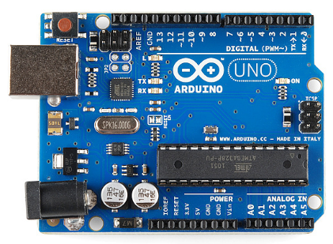
Microcontroller Specifications
Relatively low power consumption (must be able to support a battery backup that lasts up to 1 year)
Must be able to acquire accurate clock time
Must be able to interface with a large display
Must have wireless interface for uploading new information
Wireless interface must be secure
Long-term: Have the ability to synchronize multiple microcontrollers together that use the same information source.

Slide 8
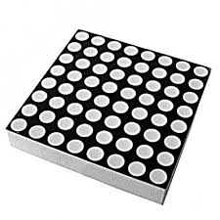
Display Specifications
External Power Supplies
35 W 120 VAC Input 7V Output
Message Loader
RS232 Serial Adapter for 25-pin and 9-pin Serial Ports
Ethernet Adapter Kits/ Wireless Broadcast Receiver Capabilities
Remote Control Keyboard
BetaBrite infrared remote

